Slide 2
Welcome:
Chris Clifton,
Watertown Development Company

Slide 3
Watertown Area
Child Care Landscape Analysis Report

Slide 4
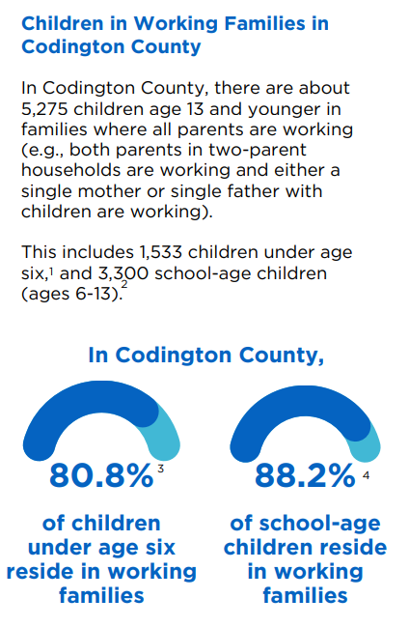
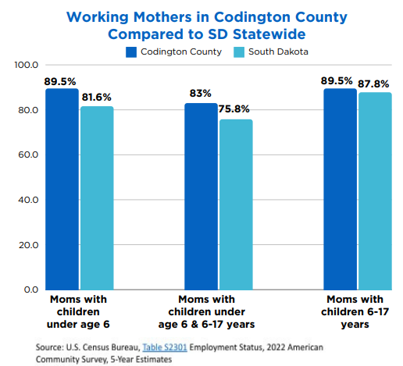

Slide 5
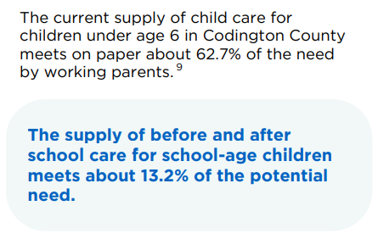
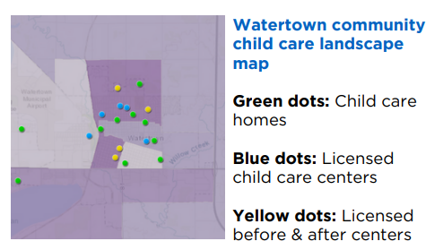
The U.S. Census Bureau Economic Survey includes estimates of sole proprietors by industry across states subdivided by county. In Codington County, there are 99 home-based child care businesses that reported annual revenue of $3.5 million in 2021. It is not possible to know how many children are in their care.

Slide 6
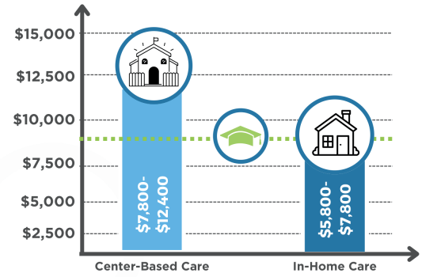
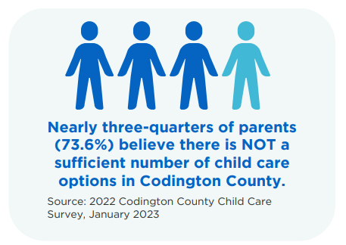
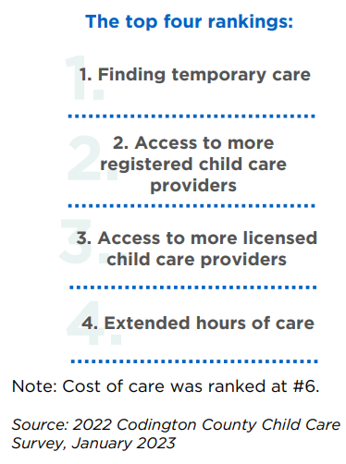
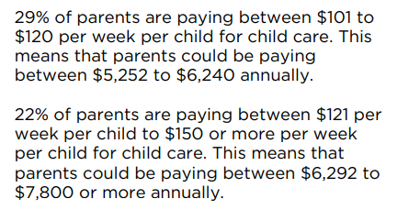
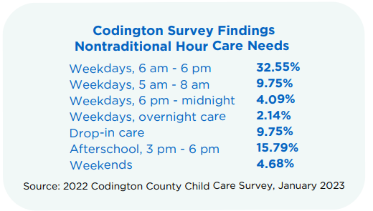

Slide 7
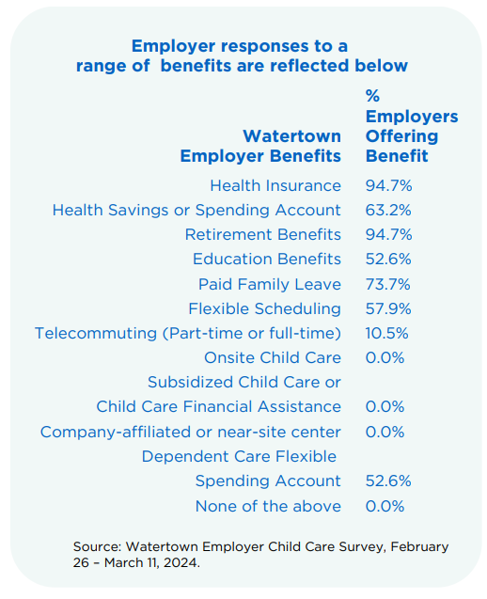
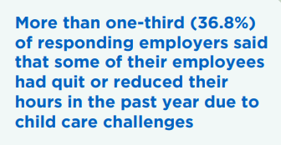
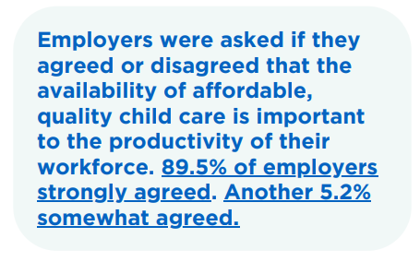

Slide 11
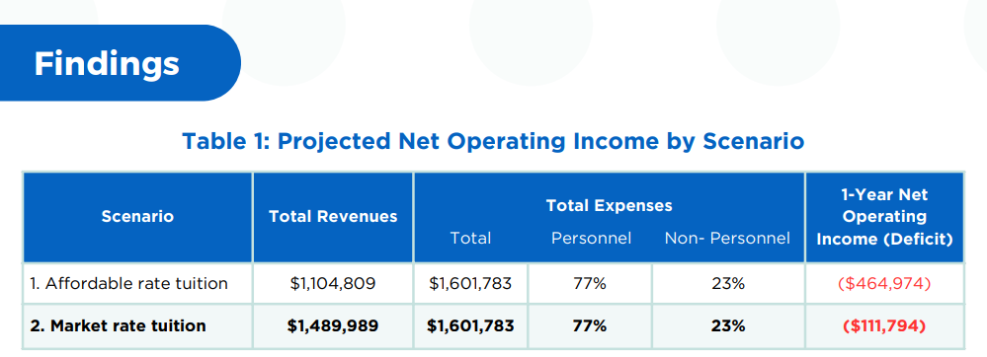

Slide 12
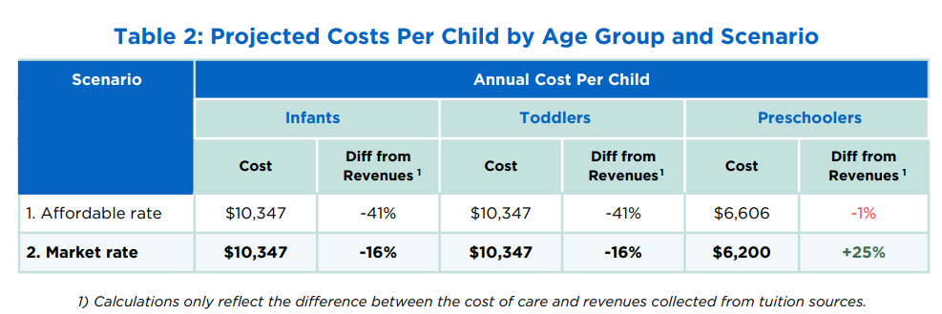

Slide 14
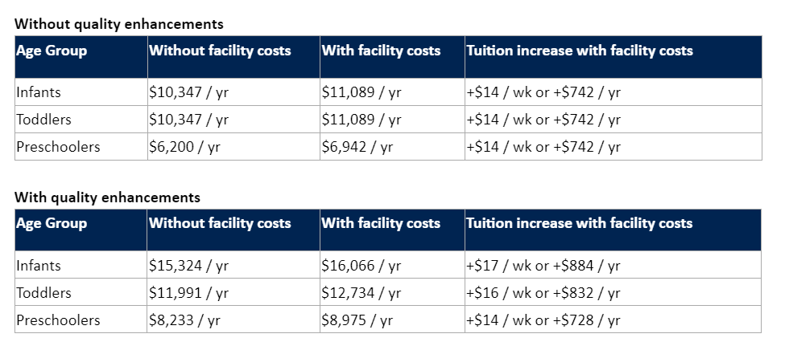

Slide 15
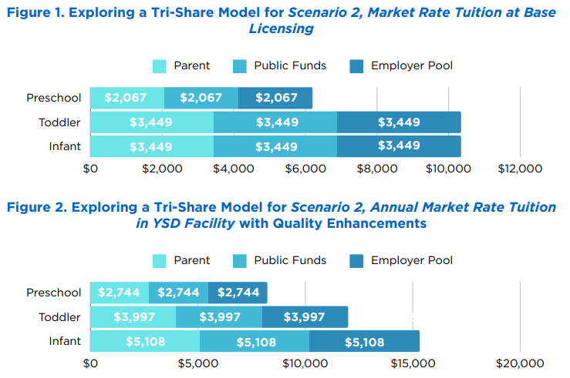

Slide 16
Conclusion and Recommendations
Parent and Consumer Help
Hosting meetings with providers to increase communication and awareness of services to parents
Platforms such as BridgeCare
Consumer / Parent Supports
Local listing of providers
Department of Social Services tools

Slide 17
Conclusion and Recommendations: Providers
Support to Child Care Workforce
Wage Supplement Program (Maine and Minnesota examples)
Benefits (such as Optima $8 a month for virtual care)
CTE and CDA programs through school district
State Support
Enrichment Offices: many offerings that providers may not be aware of
Online Share resources platform (CCA for Social Good)
Encourage marketing campaign for DSS
Director and Family Child Care support Groups
Meeting place for providers and Directors or learning opportunities

Slide 18
Conclusion and Recommendations Employers
Periodically survey employees. The Yankton employer survey found that about 1/2 of employers periodically survey employees.
Federal Tax Credit. The tax credit is worth 25 percent of expenditures for child care, up to $150,000 annually.
Employee Scheduling Notice. Advance notice will help parents and providers
Employer Dependent Care Assistance 32% of employers already offer
$5,000 tax free
Employer Supporting Match Grants one example would be a Tri-Share model

Slide 19
Conclusion and Recommendations Policy Makers
Raise Visibility of Child Care Assistance Program State or local Yankton efforts could work on increasing the visibility of this program
Massive underutilization
Supply expansion: Consider offering a $2,500 - $3,000 start-up grant to home based providers to offer registered care.
Stabilization/Operational Dollars to Registered Providers
Similar ARPA dollars

Slide 20
Conclusion and Recommendations Policy Makers
Non Traditional Hours Support for Providers
Consider contracts with local providers to incent them to start-up non-traditional hours.
Additional training and communication is a must
New Child Care Development Fund (CCDF) rule changes is an option - portion for grants and contracts
Data Tracking
Capacity tracking by age
Cost Modeling

Slide 21
THANK YOU
Scan the QR Code below to review the full report

Slide 22
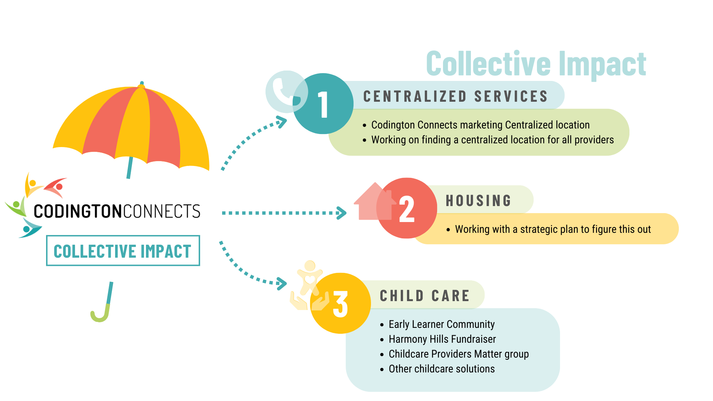

Slide 23
Solutions and Watertown Moving Forward
Sara Foust, Codington County Community Services
Explore & support expansion - Monastery & Educare
In-home providers group - Watertown Childcare Providers Matter
New options - Roosevelt as another community option

Slide 24
Early Learner Community
Audrey Rider

Slide 25
Transition of Harmony Hills
Sr. Barb Younger

Slide 26
Lake Area Tech
Tiffany Sanderson

Slide 27
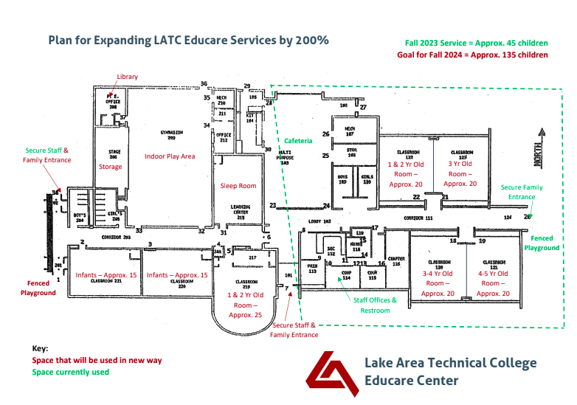

Slide 28
Call to Action
Chris Clifton, Watertown Development Company

Slide 29
Wrap Up and Questions
Sara Foust

